Slide 1
C++ is Fun – Part 12 at Turbine/Warner Bros.!
Russell Hanson

Slide 2
Syllabus
1) First program and introduction to data types and control structures with applications for games learning how to use the programming environment Mar 25-27
2) Objects, encapsulation, abstract data types, data protection and scope April 1-3
3) Basic data structures and how to use them, opening files and performing operations on files – April 8-10
4) Algorithms on data structures, algorithms for specific tasks, simple AI and planning type algorithms, game AI algorithms April 15-17
Project 1 Due – April 17
5) More AI: search, heuristics, optimization, decision trees, supervised/unsupervised learning – April 22-24
6) Game API and/or event-oriented programming, model view controller, map reduce filter – April 29, May 1
7) Basic threads models and some simple databases SQLite May 6-8
8) Graphics programming, shaders, textures, 3D models and rotations May 13-15
Project 2 Due May 15
9) How to download an API and learn how to use functions in that API, Windows Foundation Classes May 20-22
10) Designing and implementing a simple game in C++ May 27-29
11) Selected topics – Gesture recognition & depth controllers like the Microsoft Kinect, Network Programming & TCP/IP, OSC June 3-5
12) Working on student projects - June 10-12
Final project presentations Project 3/Final Project Due June 12

Slide 3
Woah! Tic Tac Toe!!!
Welcome to Tic-Tac-Toe
You will make your move by entering a number, 0-8.
The number will correspond to the board position as illustrated:
0 | 1 | 2
3 | 4 | 5
6 | 7 | 8
You want to go first? (y/n) : y
You want to be X or O? (x/o) : X
You want to be X or O? (x/o) : x
| | |
| | |
| | |
Where do you want to move? (0 - 8): 0
X | | |
| | |
| | |
X | | |
| O | |
| | |
Where do you want to move? (0 - 8): 8
X | | |
| O | |
| | X |
X | | O |
| O | |
| | X |
Where do you want to move? (0 - 8): 6
X | | O |
| O | |
X | | X |
X | | O |
| O | |
X | O | X |
Where do you want to move? (0 - 8): 1
X | X | O |
| O | |
X | O | X |
X | X | O |
O | O | |
X | O | X |
Where do you want to move? (0 - 8): 5
X | X | O |
O | O | X |
X | O | X |
TIE!
sh: PAUSE: command not found
Russells-MacBook-Pro:mgraessle_Homework4 russell$
X | | O |
| O | |
X | O | X |
Where do you want to move? (0 - 8): 1
X | X | O |
| O | |
X | O | X |
X | X | O |
O | O | |
X | O | X |
Where do you want to move? (0 - 8): 5
X | X | O |
O | O | X |
X | O | X |
TIE!
sh: PAUSE: command not found
Russells-MacBook-Pro:mgraessle_Homework4 russell$

Slide 4
/*
Use the current empty pieces to have the computer
choose the best move to counter the last human move
*/
void Board::computerMove()
{
// set the list of all the ways to win
int WAYS_TO_WIN [8][3] = {{0, 1, 2},
{3, 4, 5},
{6, 7, 8},
{0, 3, 6},
{1, 4, 7},
{2, 5, 8},
{0, 4, 8},
{2, 4, 6}};
// if computer can win, take that move
for (int i = 0; i < 8; ++i)
{
if ( board_pieces[WAYS_TO_WIN[i][0]] == COMPUTER && board_pieces[WAYS_TO_WIN[i][1]] == COMPUTER && board_pieces[WAYS_TO_WIN[i][2]] == EMPTY) {
setPiece(WAYS_TO_WIN[i][2], COMPUTER);
return;
}
else {
if ( board_pieces[WAYS_TO_WIN[i][1]] == COMPUTER && board_pieces[WAYS_TO_WIN[i][2]] == COMPUTER && board_pieces[WAYS_TO_WIN[i][0]] == EMPTY) {
setPiece(WAYS_TO_WIN[i][0], COMPUTER);
return;
}
else {
if ( board_pieces[WAYS_TO_WIN[i][0]] == COMPUTER && board_pieces[WAYS_TO_WIN[i][2]] == COMPUTER && board_pieces[WAYS_TO_WIN[i][1]] == EMPTY )
{
setPiece(WAYS_TO_WIN[i][1], COMPUTER);
return;
}
}
}
}
// if human can win, block that move
for (int i = 0; i < 8; ++i)
{
if ( board_pieces[WAYS_TO_WIN[i][0]] == HUMAN && board_pieces[WAYS_TO_WIN[i][1]] == HUMAN && board_pieces[WAYS_TO_WIN[i][2]] == EMPTY) {
setPiece(WAYS_TO_WIN[i][2], COMPUTER);
return;
}
else {
if ( board_pieces[WAYS_TO_WIN[i][1]] == HUMAN && board_pieces[WAYS_TO_WIN[i][2]] == HUMAN && board_pieces[WAYS_TO_WIN[i][0]] == EMPTY) {
setPiece(WAYS_TO_WIN[i][0], COMPUTER);
return;
}
else {
if ( board_pieces[WAYS_TO_WIN[i][0]] == HUMAN && board_pieces[WAYS_TO_WIN[i][2]] == HUMAN && board_pieces[WAYS_TO_WIN[i][1]] == EMPTY )
{
setPiece(WAYS_TO_WIN[i][1], COMPUTER);
return;
}
}
}
}
int BEST_MOVES[10] = {4, 0, 2, 6, 8, 1, 3, 5, 7};
// if one of the best squares is empty, take it
for (int i = 0; i < 10; ++i)
{
if ( isMoveLegal(BEST_MOVES[i]) )
{
setPiece(BEST_MOVES[i], COMPUTER);
break;
}// end if
}// end for
}// end computerMove

Slide 5
/*
Use the current empty pieces to have the computer
choose the best move to counter the last human move
*/
void Board::computerMove()
{
// set the list of all the ways to win
int WAYS_TO_WIN [8][3] = {{0, 1, 2},
{3, 4, 5},
{6, 7, 8},
{0, 3, 6},
{1, 4, 7},
{2, 5, 8},
{0, 4, 8},
{2, 4, 6}};
// if computer can win, take that move
for (int i = 0; i < 8; ++i)
{
if ( board_pieces[WAYS_TO_WIN[i][0]] == COMPUTER && board_pieces[WAYS_TO_WIN[i][1]] == COMPUTER && board_pieces[WAYS_TO_WIN[i][2]] == EMPTY) {
setPiece(WAYS_TO_WIN[i][2], COMPUTER);
return;
}
else {
if ( board_pieces[WAYS_TO_WIN[i][1]] == COMPUTER && board_pieces[WAYS_TO_WIN[i][2]] == COMPUTER && board_pieces[WAYS_TO_WIN[i][0]] == EMPTY) {
setPiece(WAYS_TO_WIN[i][0], COMPUTER);
return;
}
else {
if ( board_pieces[WAYS_TO_WIN[i][0]] == COMPUTER && board_pieces[WAYS_TO_WIN[i][2]] == COMPUTER && board_pieces[WAYS_TO_WIN[i][1]] == EMPTY )
{
setPiece(WAYS_TO_WIN[i][1], COMPUTER);
return;
}
}
}
}
// if human can win, block that move
for (int i = 0; i < 8; ++i)
{
if ( board_pieces[WAYS_TO_WIN[i][0]] == HUMAN && board_pieces[WAYS_TO_WIN[i][1]] == HUMAN && board_pieces[WAYS_TO_WIN[i][2]] == EMPTY) {
setPiece(WAYS_TO_WIN[i][2], COMPUTER);
return;
}
else {
if ( board_pieces[WAYS_TO_WIN[i][1]] == HUMAN && board_pieces[WAYS_TO_WIN[i][2]] == HUMAN && board_pieces[WAYS_TO_WIN[i][0]] == EMPTY) {
setPiece(WAYS_TO_WIN[i][0], COMPUTER);
return;
}
else {
if ( board_pieces[WAYS_TO_WIN[i][0]] == HUMAN && board_pieces[WAYS_TO_WIN[i][2]] == HUMAN && board_pieces[WAYS_TO_WIN[i][1]] == EMPTY )
{
setPiece(WAYS_TO_WIN[i][1], COMPUTER);
return;
}
}
}
}
int BEST_MOVES[10] = {4, 0, 2, 6, 8, 1, 3, 5, 7};
// if one of the best squares is empty, take it
for (int i = 0; i < 10; ++i)
{
if ( isMoveLegal(BEST_MOVES[i]) )
{
setPiece(BEST_MOVES[i], COMPUTER);
break;
}// end if
}// end for
}// end computerMove

Slide 6
Graphics and OpenGL!

Slide 7
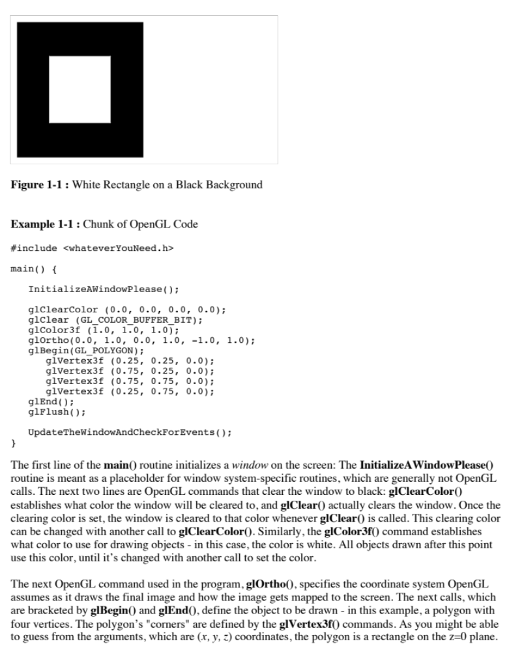

Slide 8
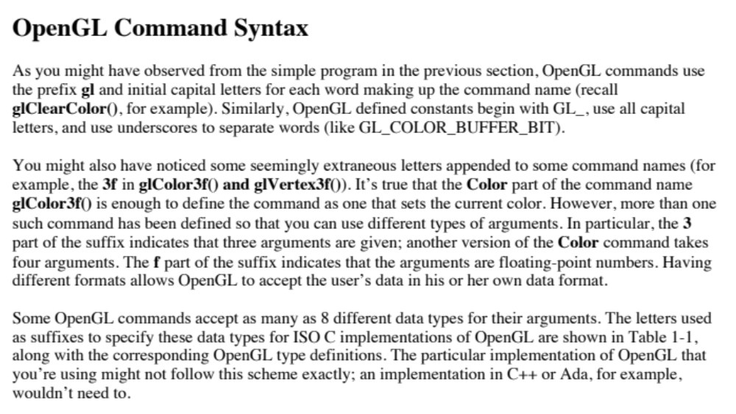

Slide 9
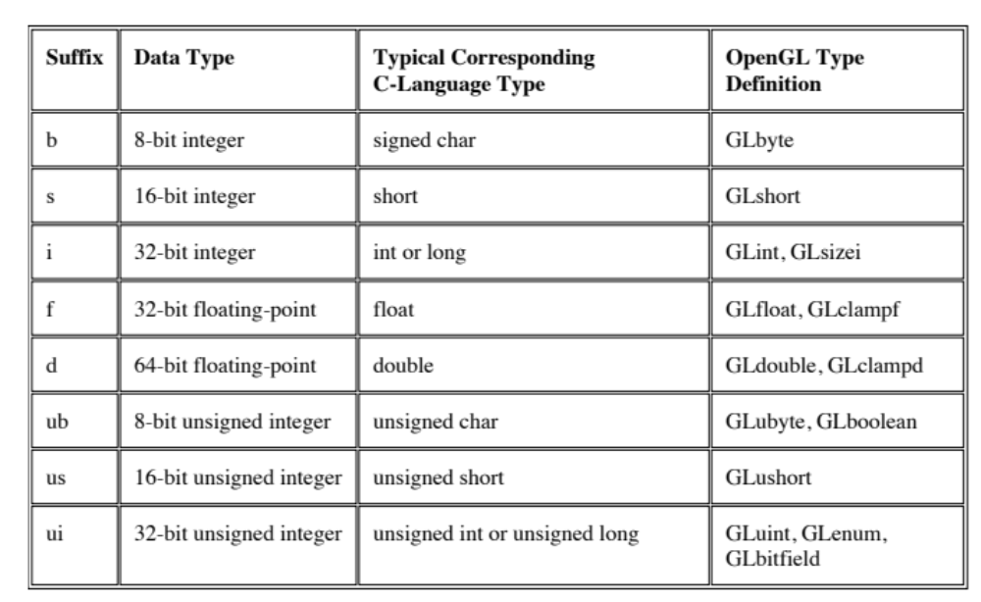

Slide 10
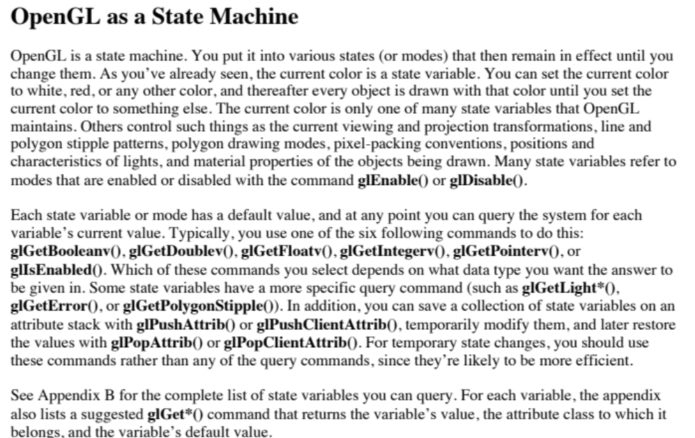

Slide 11
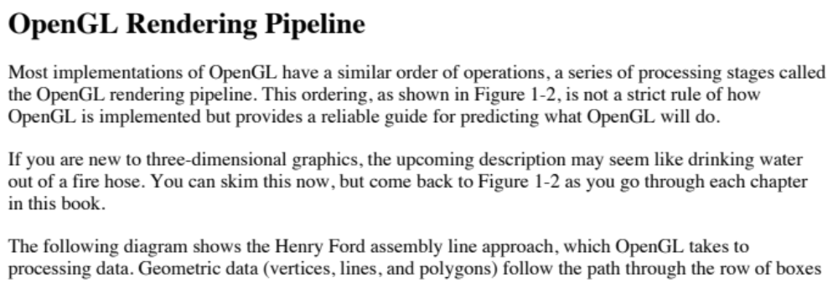
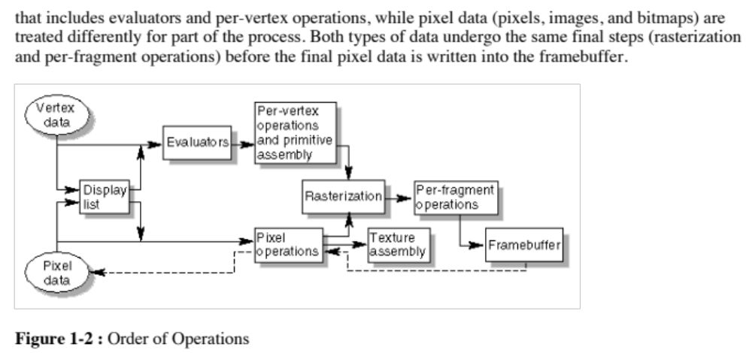

Slide 12
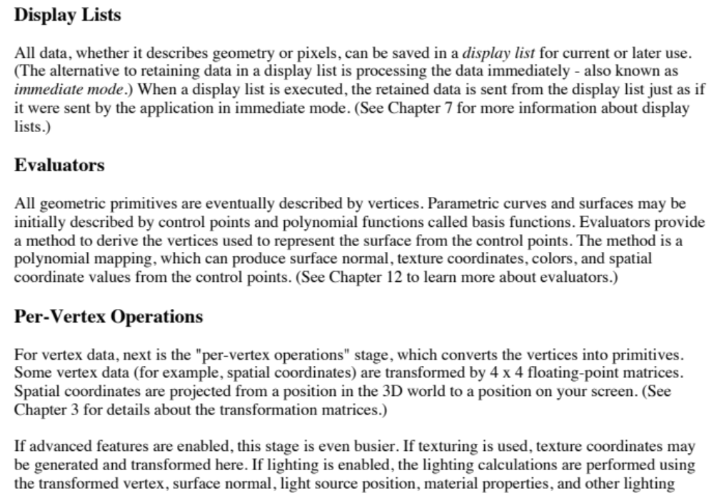

Slide 13
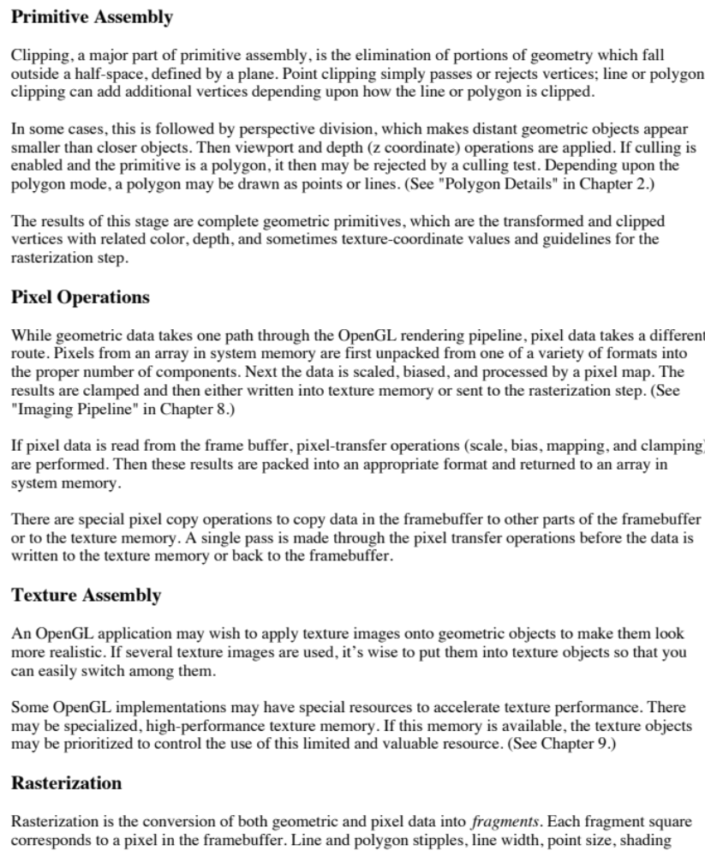

Slide 14
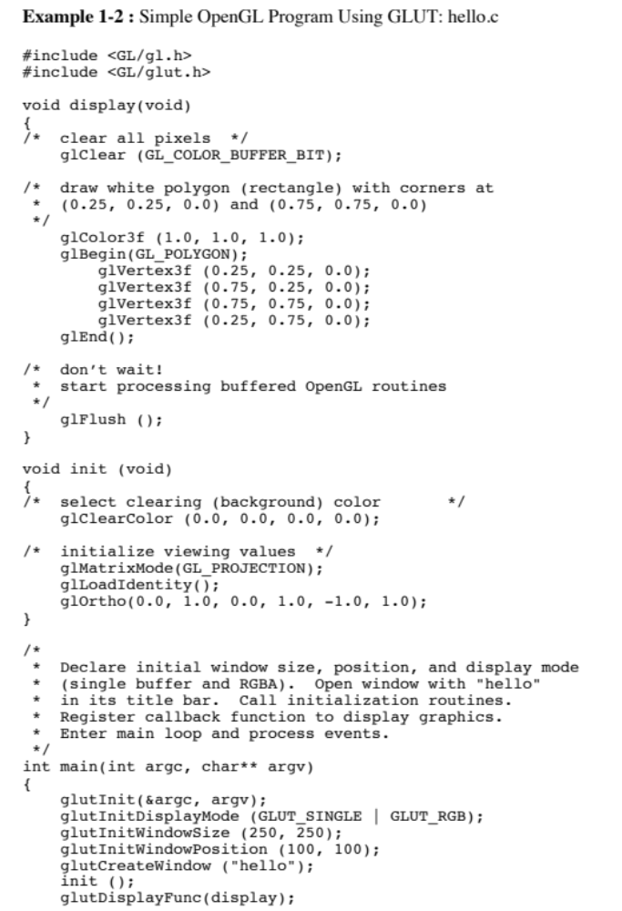
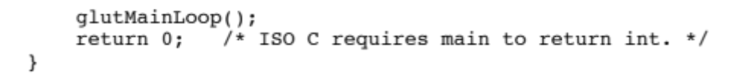

Slide 15
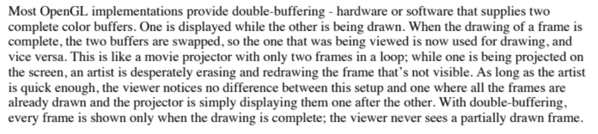
Double Buffering

Slide 16
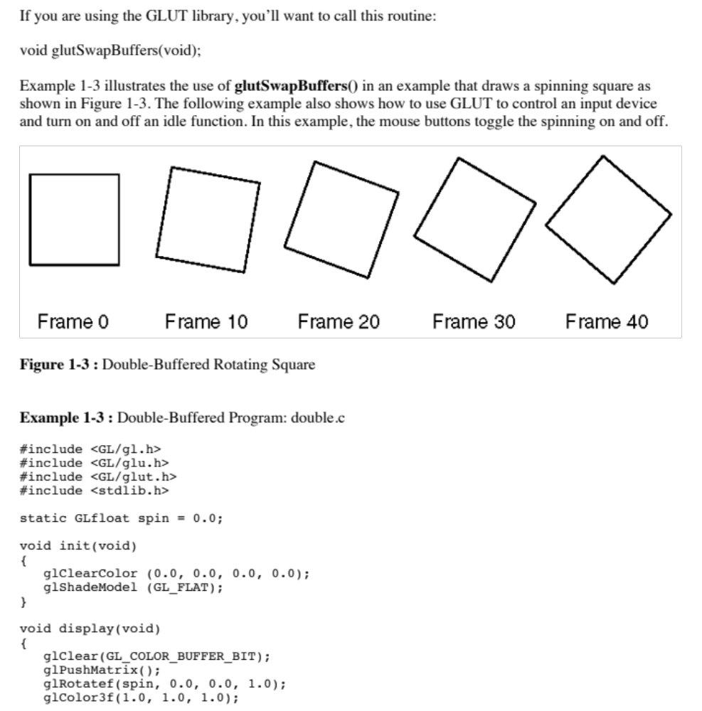

Slide 17
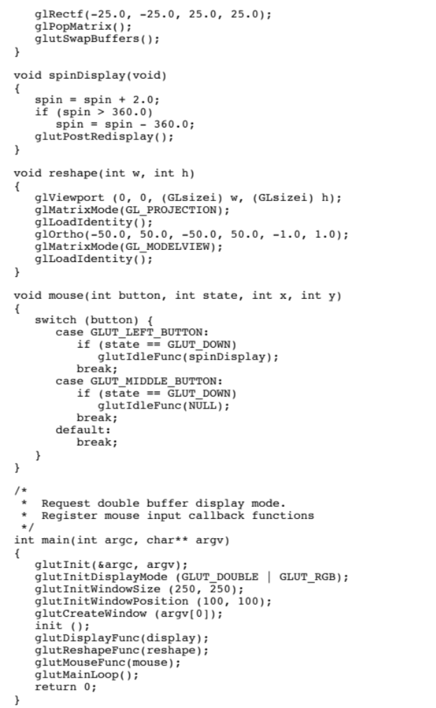

Slide 18
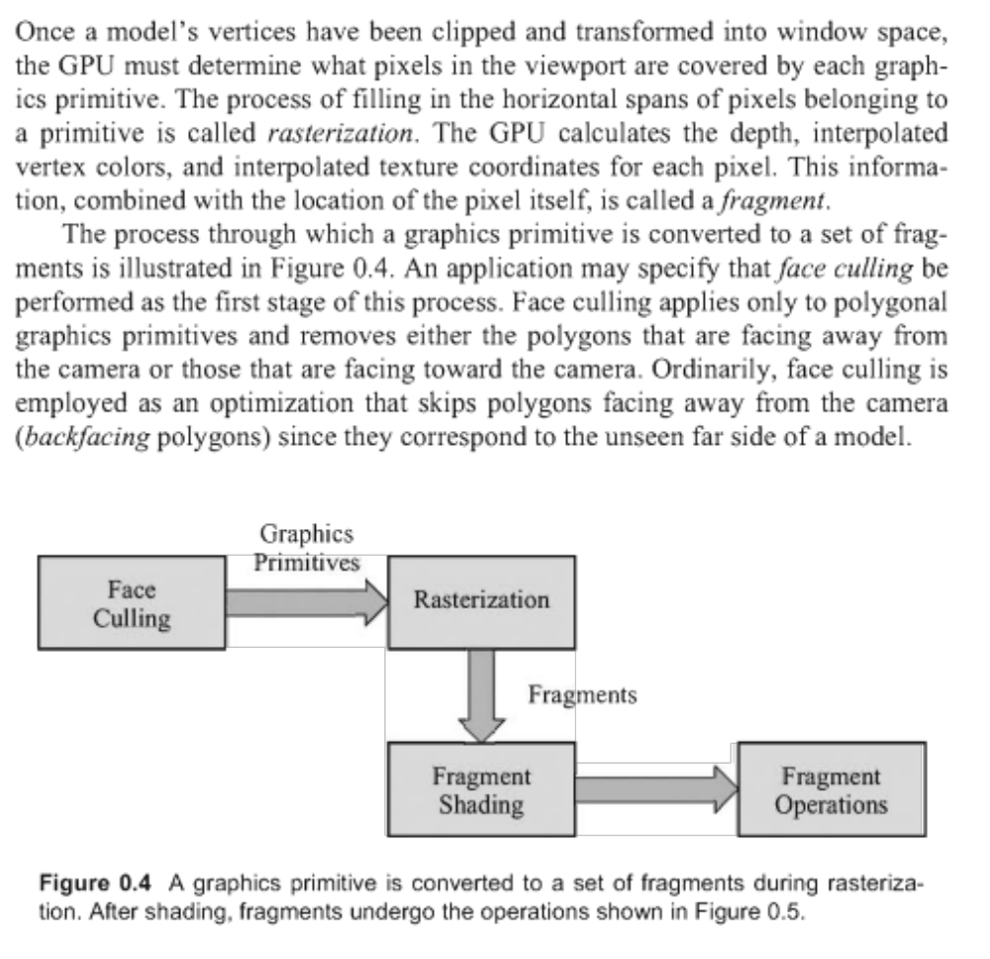

Slide 19
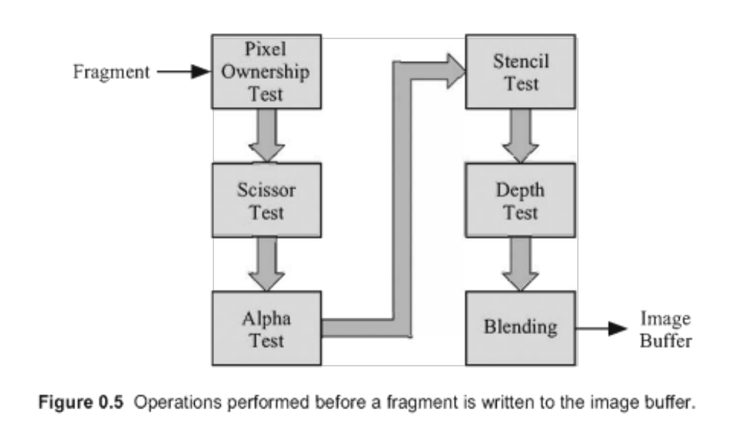

Slide 20
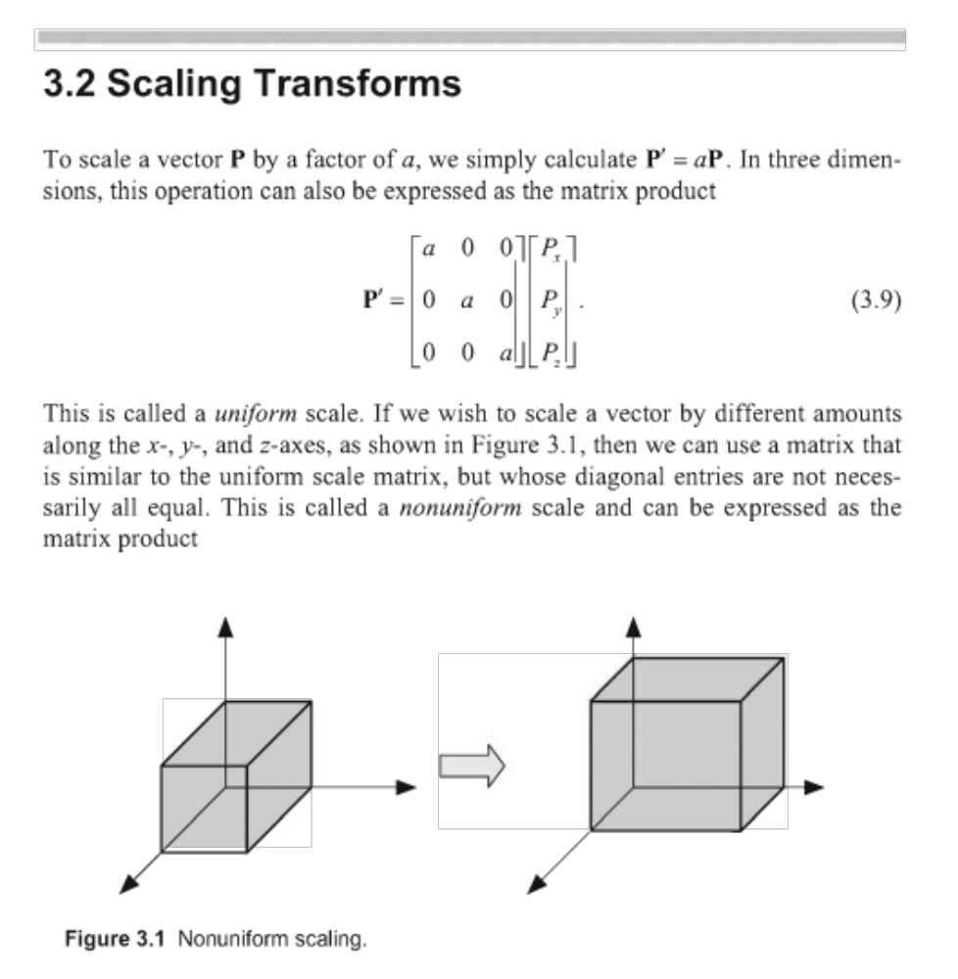

Slide 21
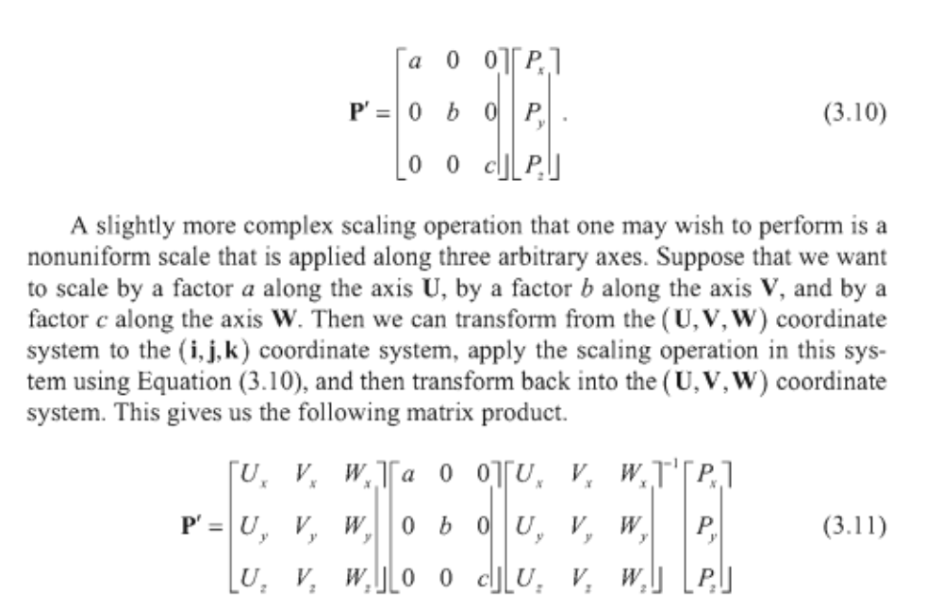

Slide 22
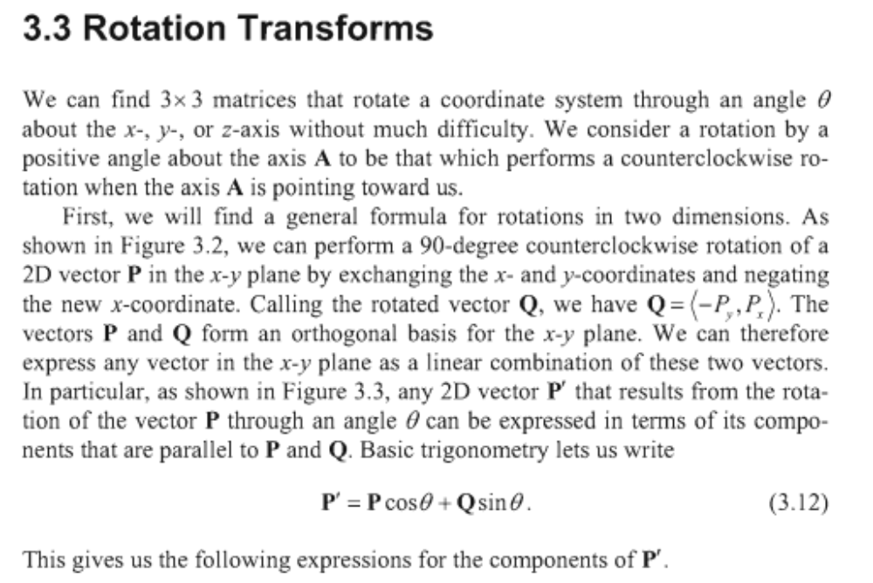

Slide 23
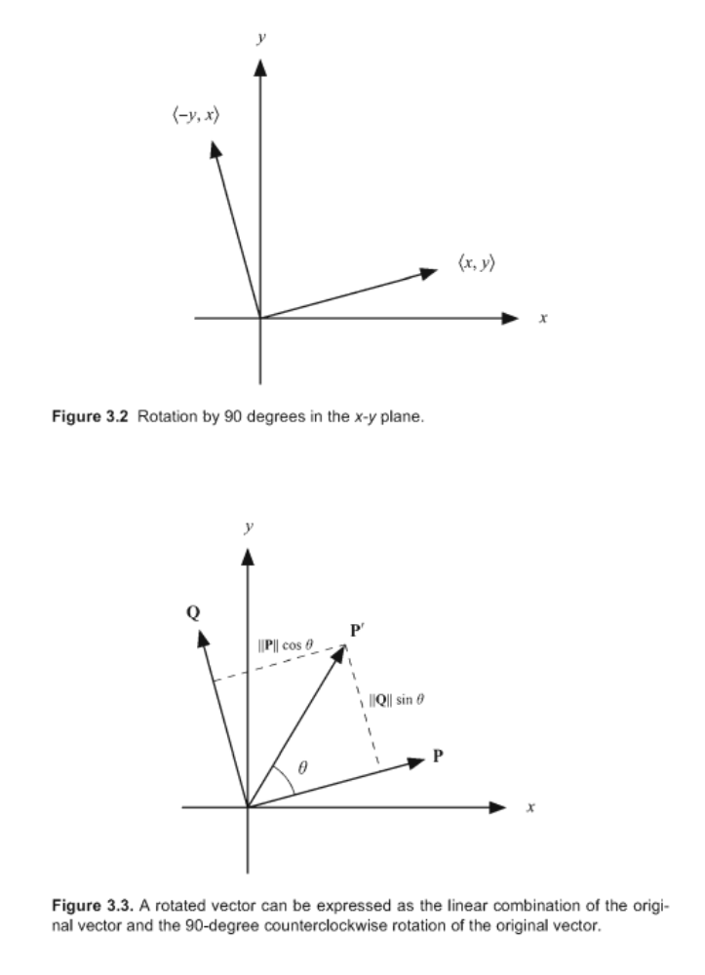

Slide 24
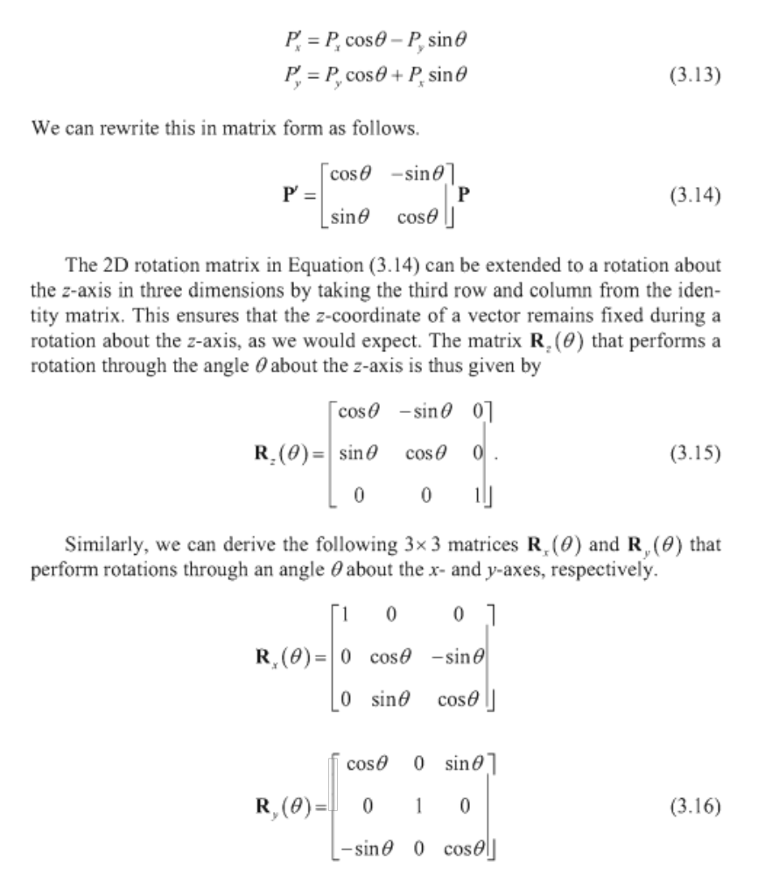

Slide 25
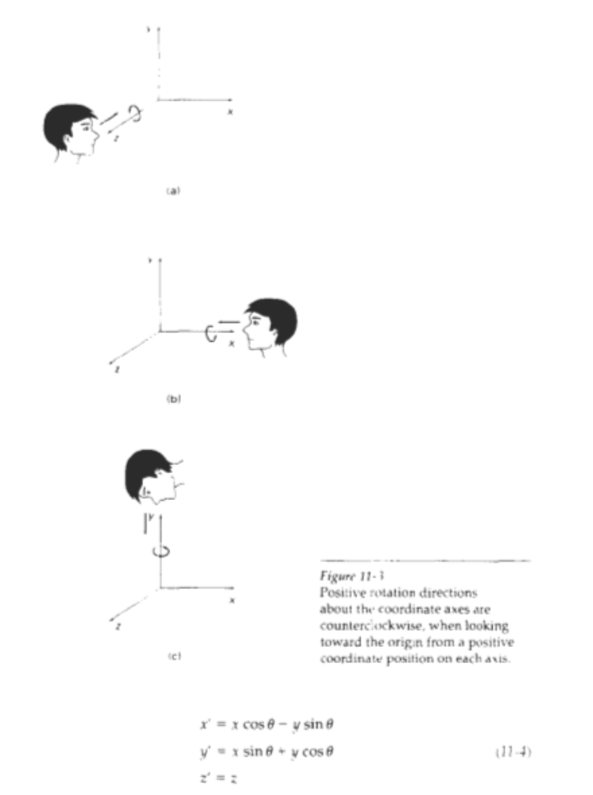

Slide 26
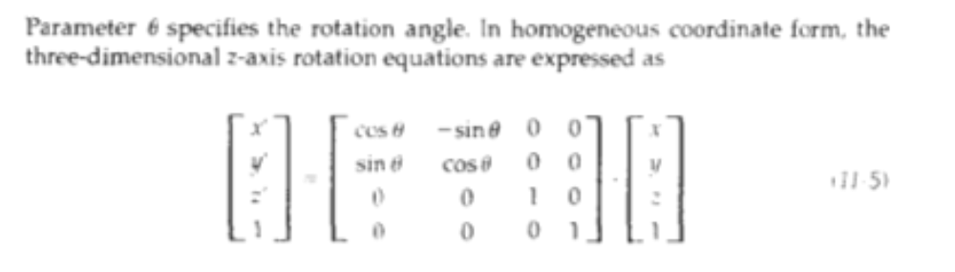
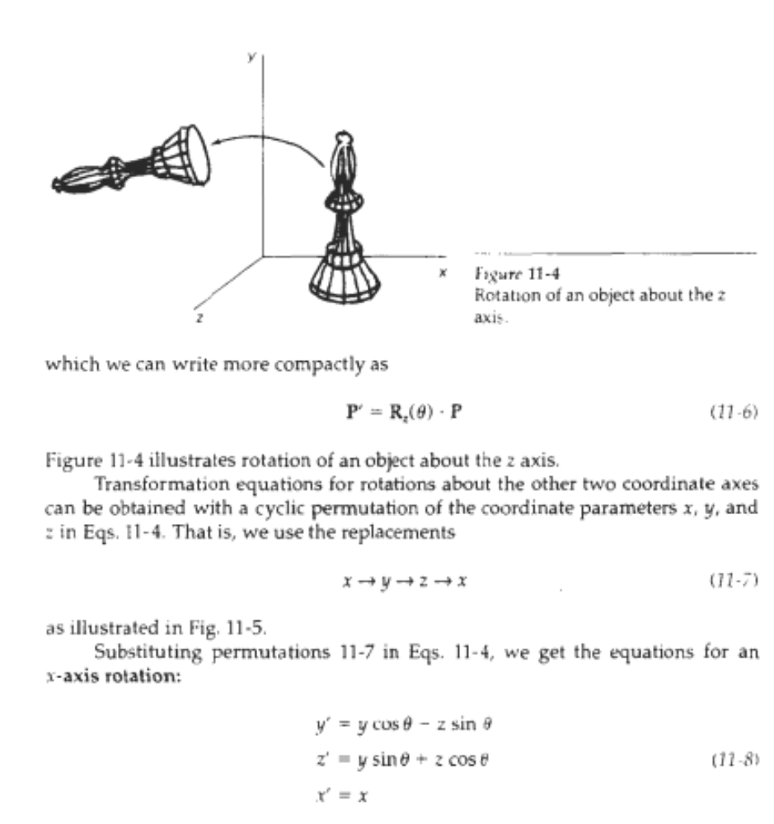

Slide 27
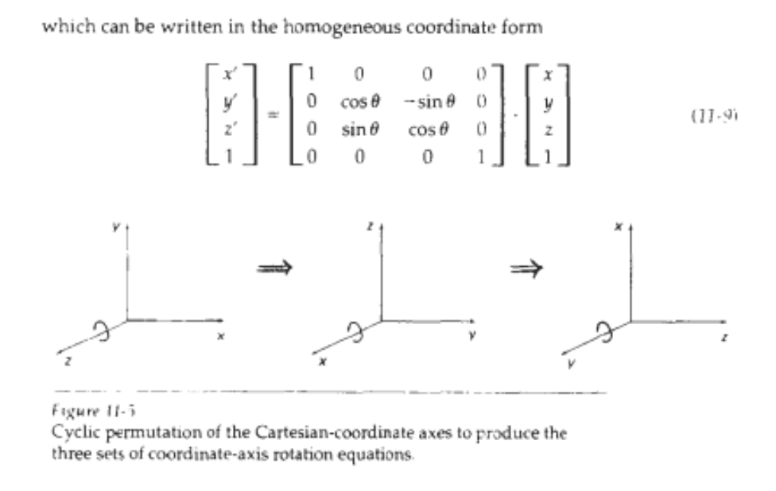
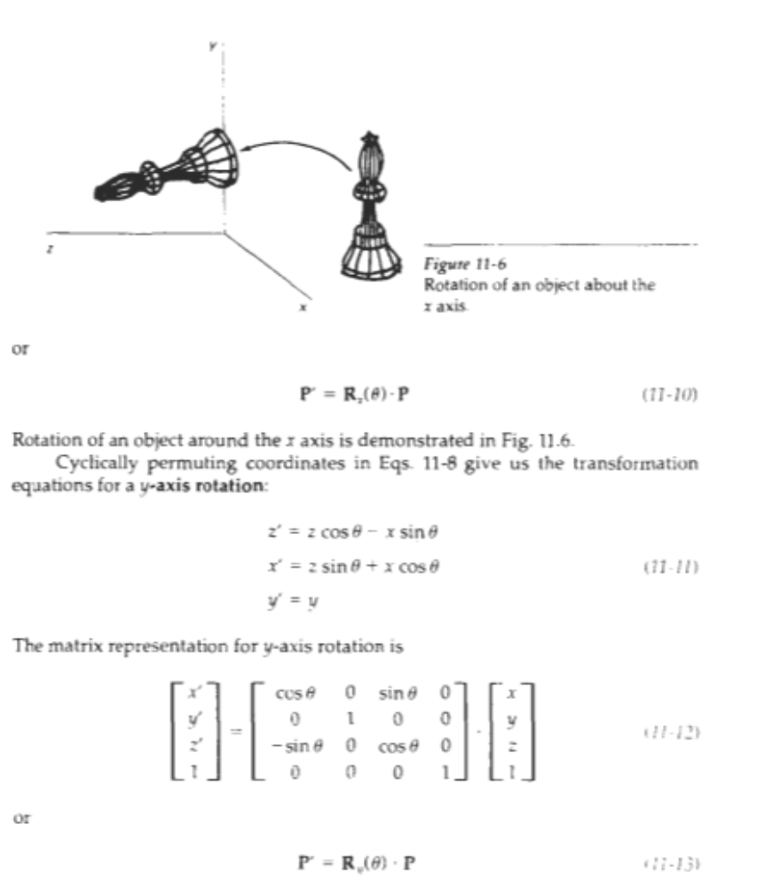

Slide 28
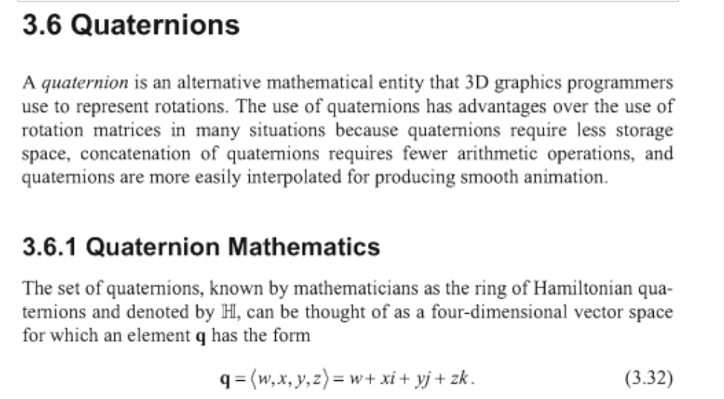

Slide 29
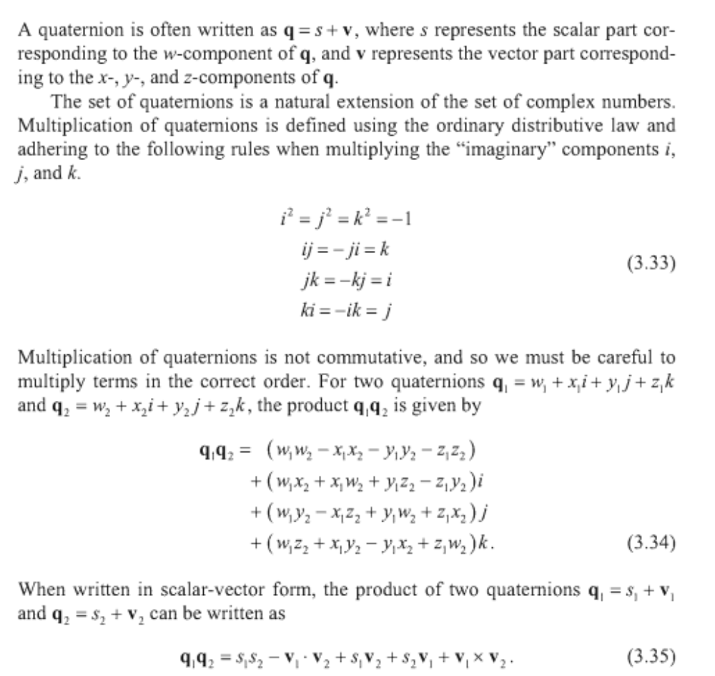

Slide 30
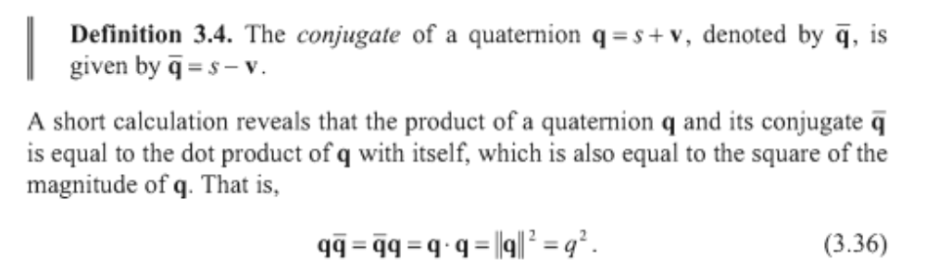
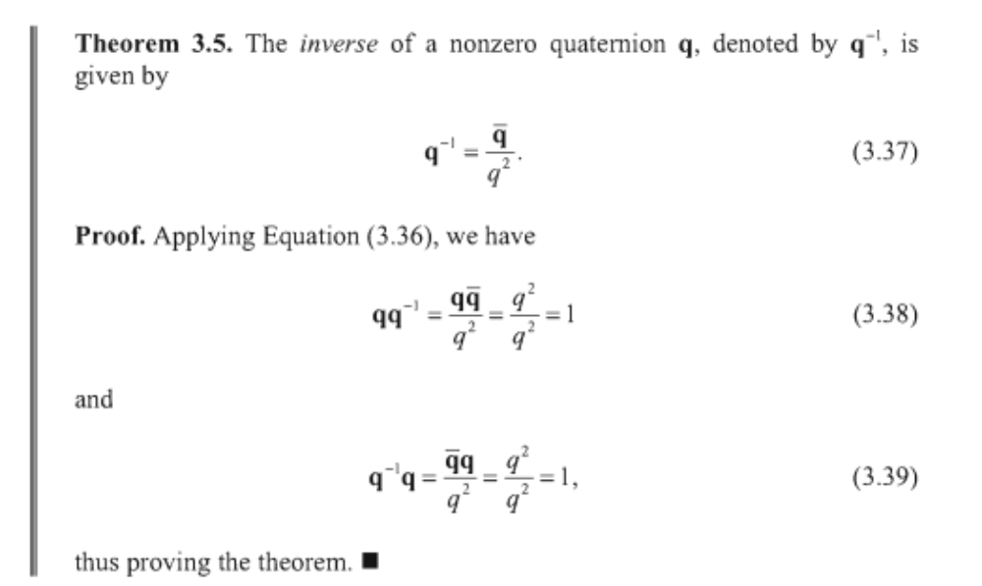

Slide 31
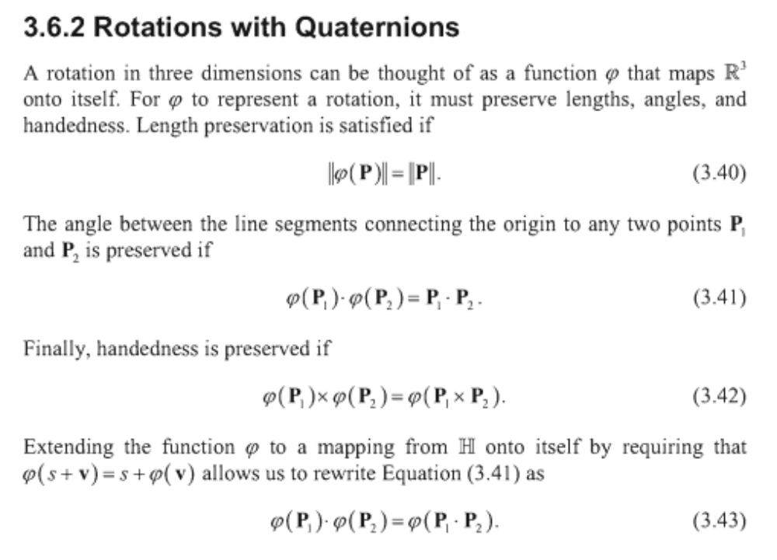

Slide 32
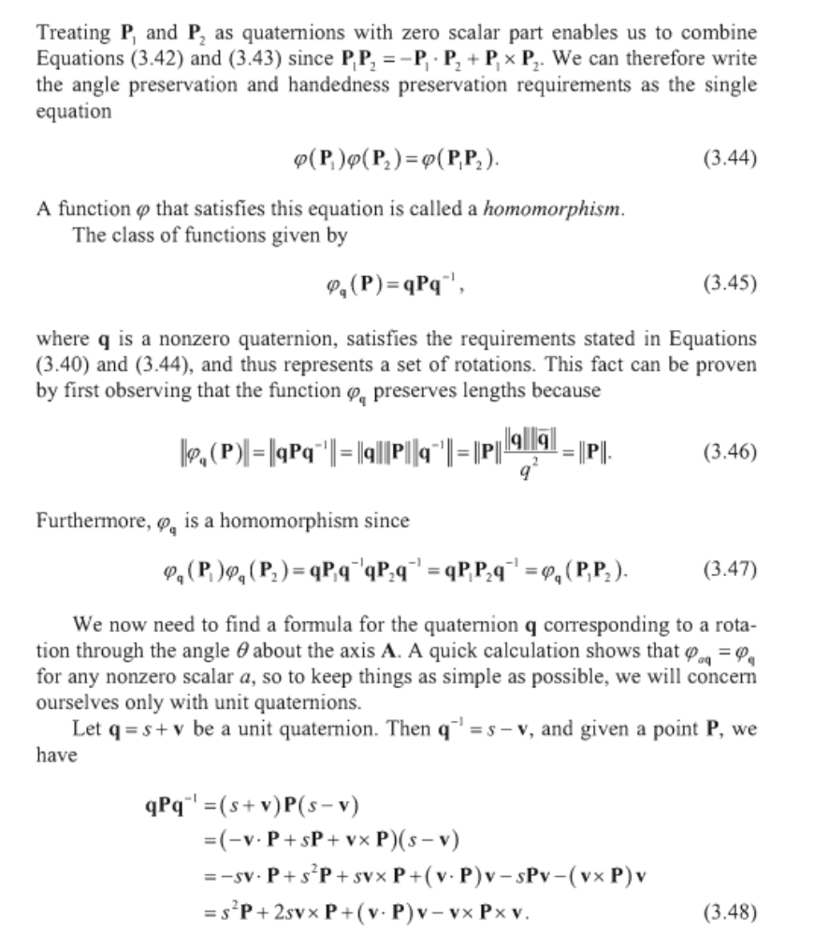

Slide 33
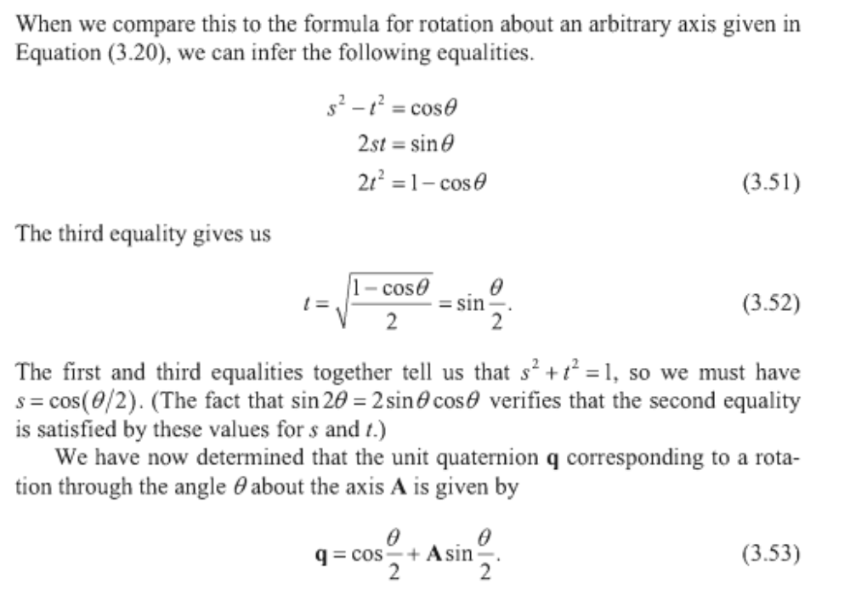

Slide 34
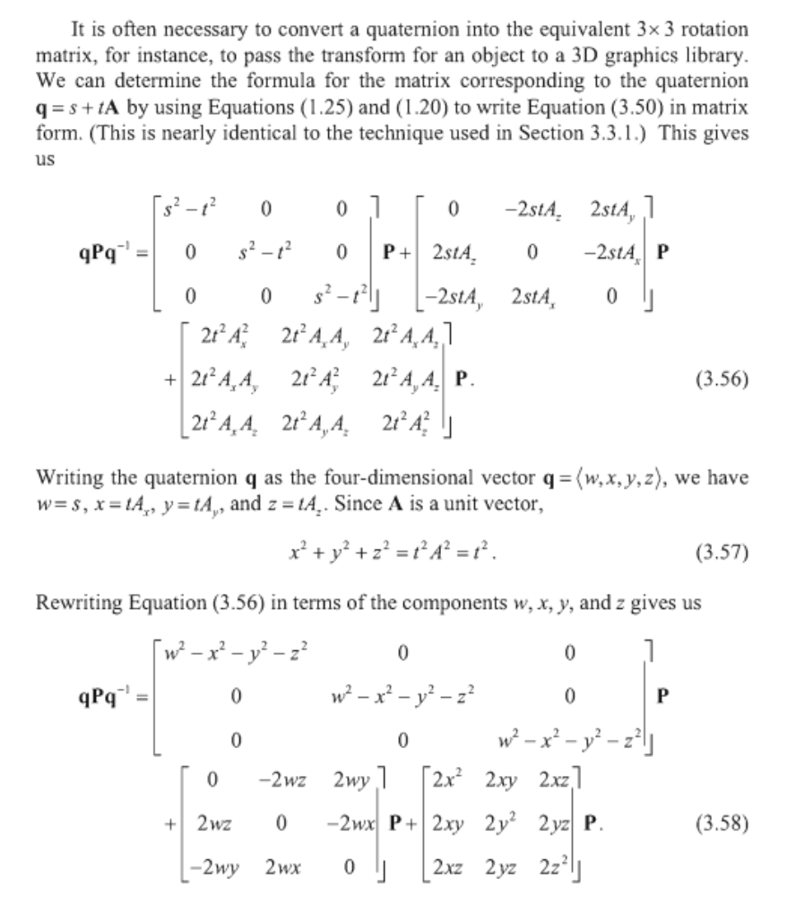

Slide 35
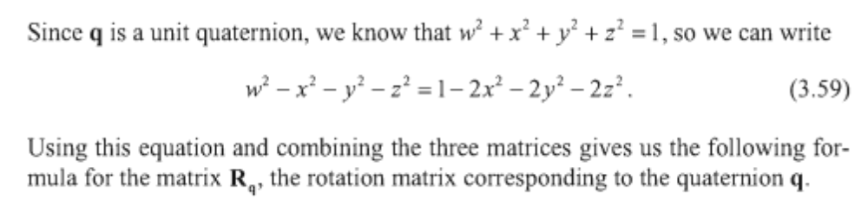
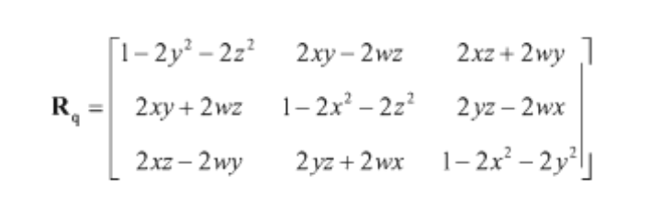

Slide 36
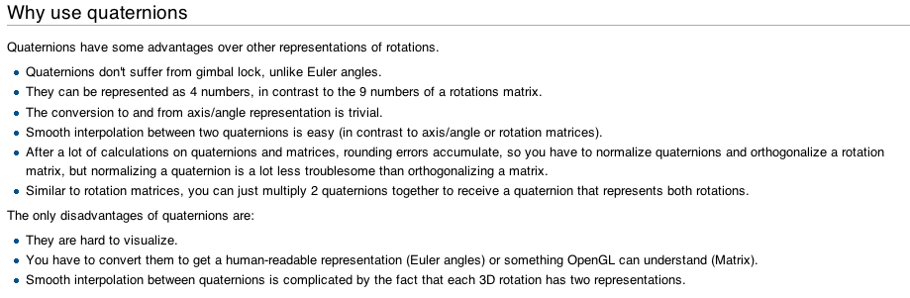

Slide 37
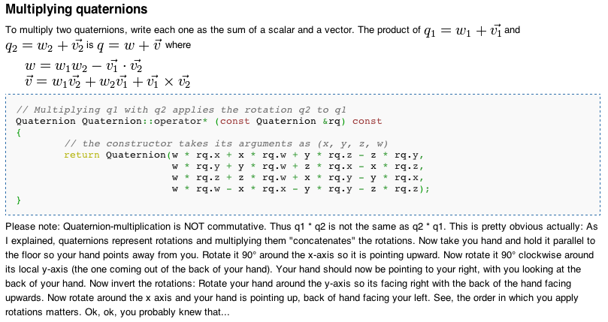

Slide 38
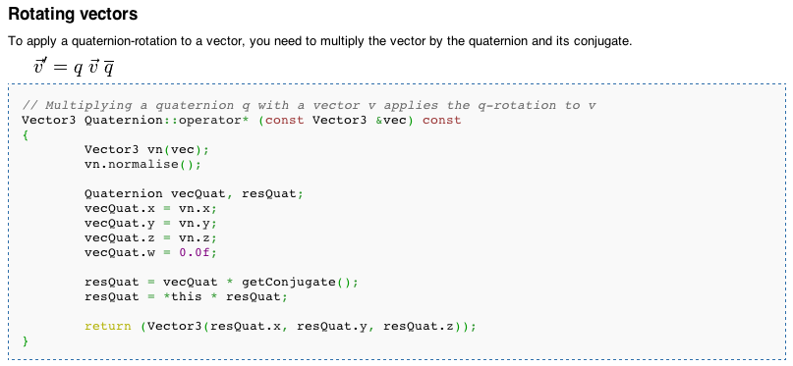

Slide 39
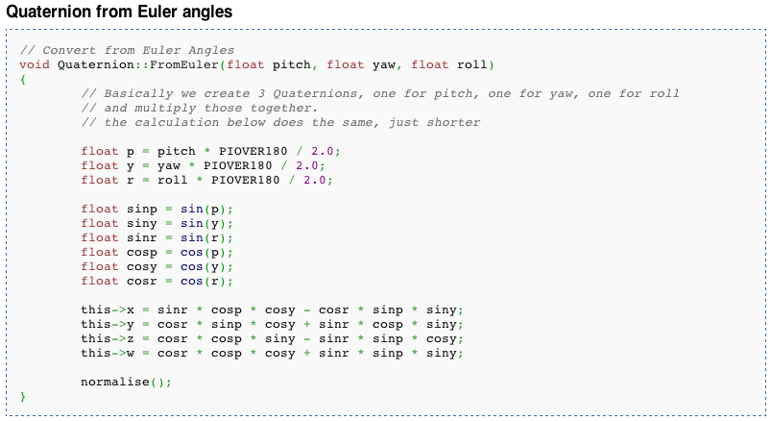

Slide 40
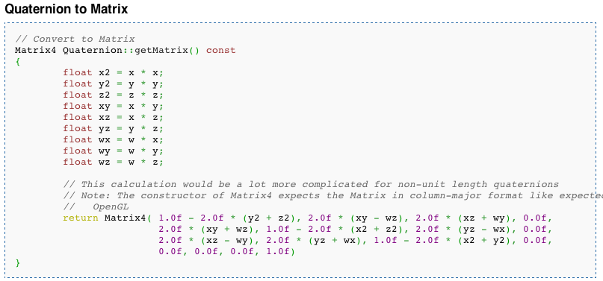

Slide 41
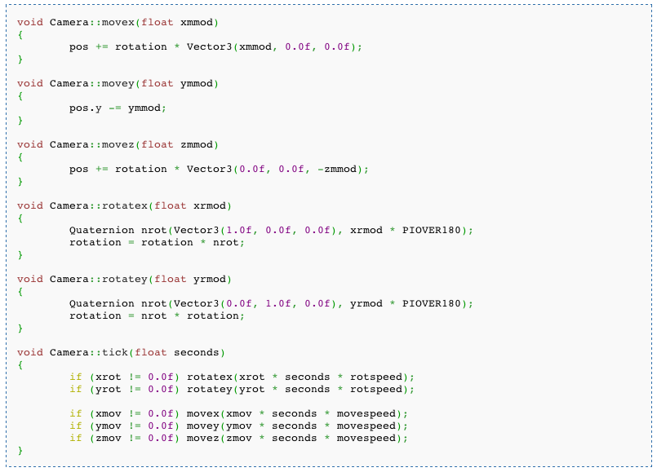

Slide 42
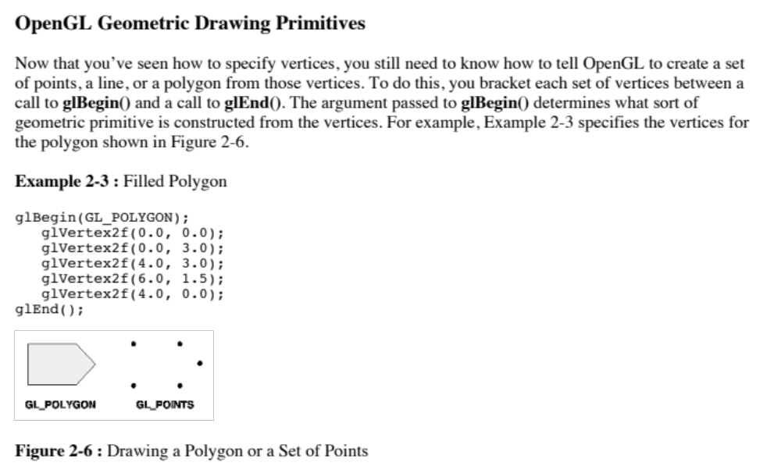

Slide 43
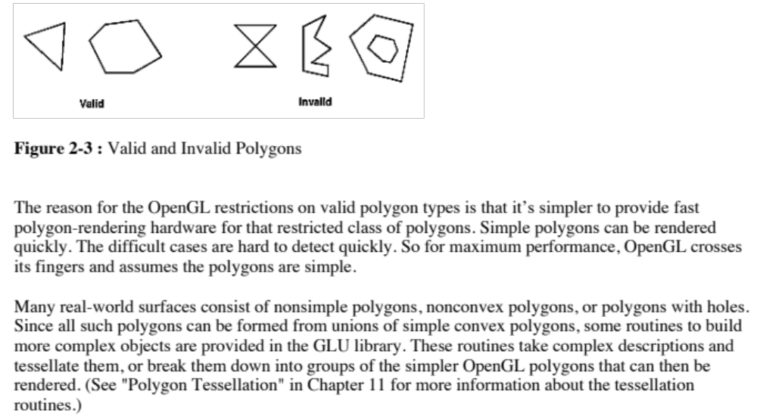

Slide 44
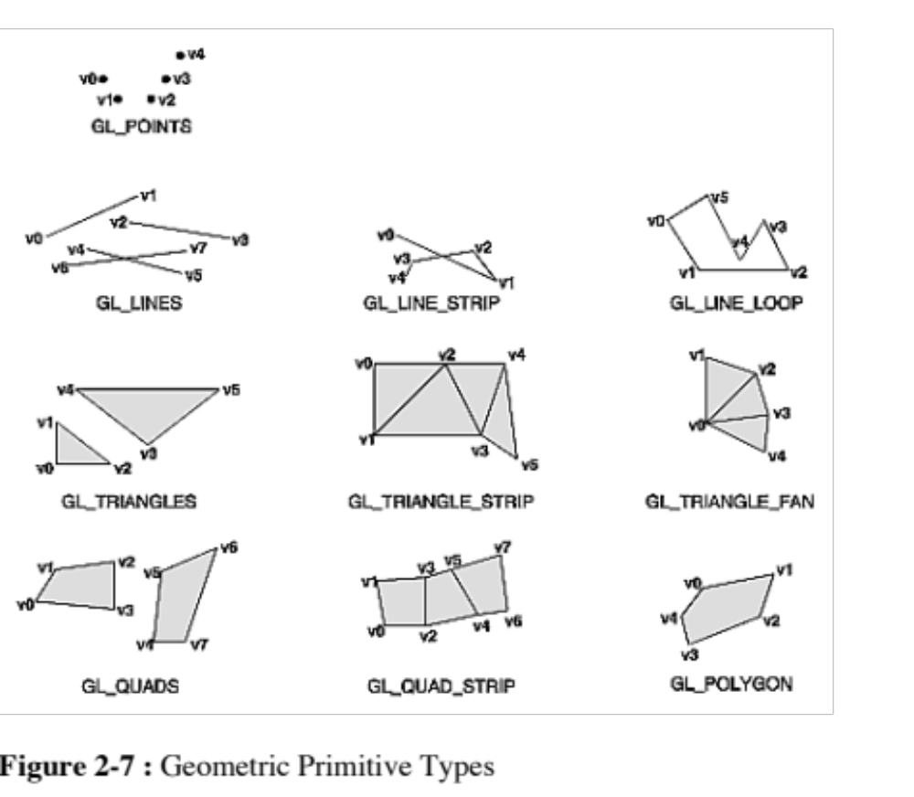

Slide 45
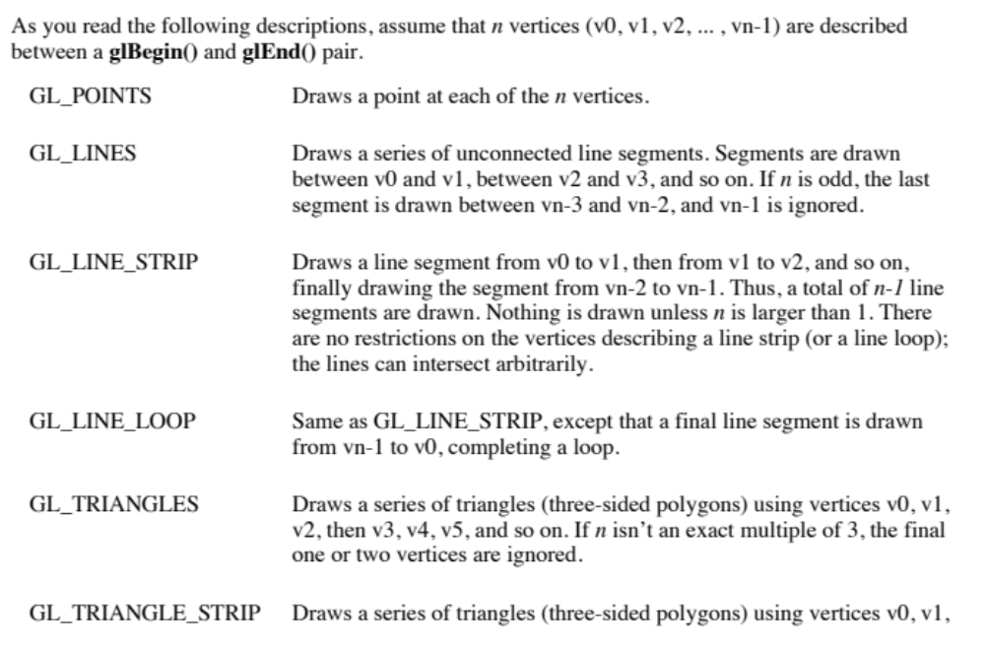

Slide 46
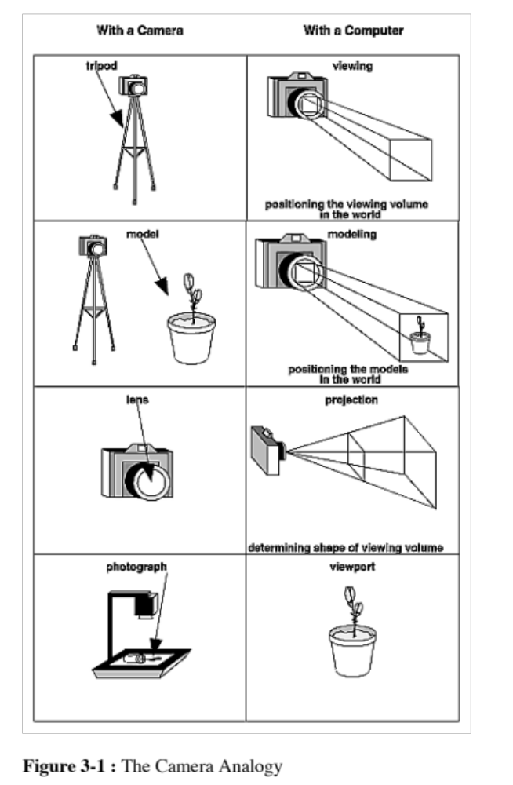

Slide 47
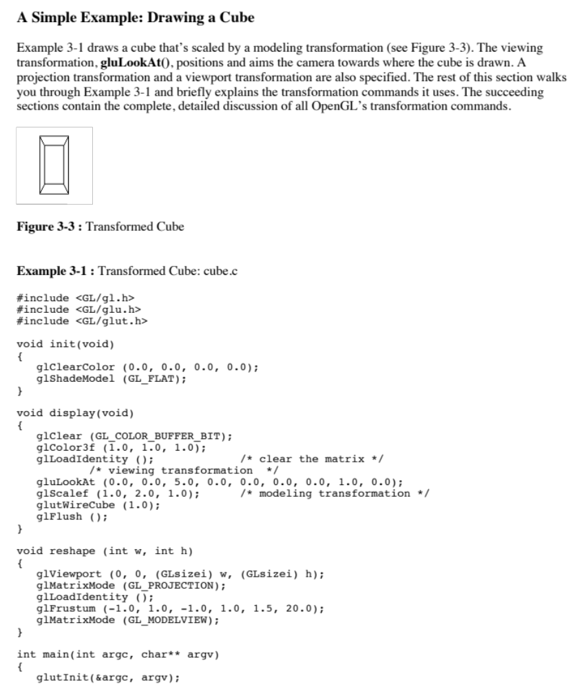
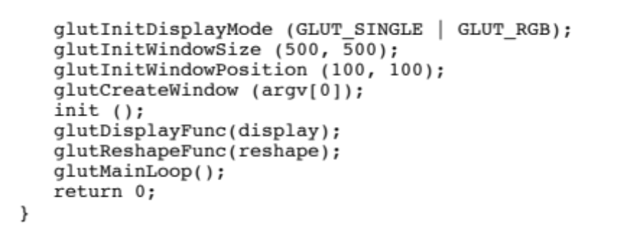

Slide 48
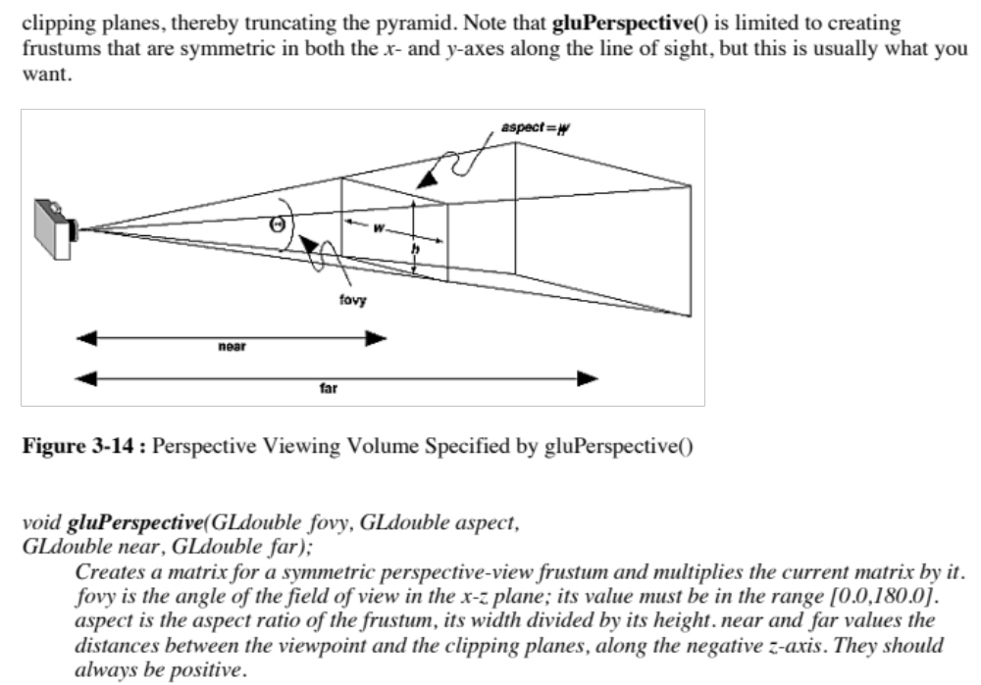

Slide 49
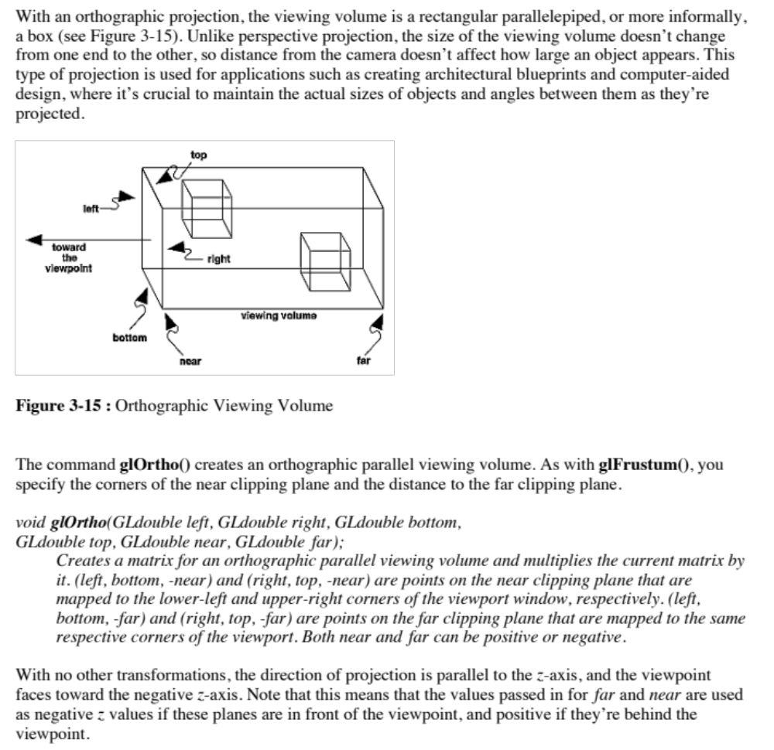

Slide 50
Some links:
http://www.glprogramming.com/manpages/opengl-quick-reference-card.pdf
The Official Guide to Learning OpenGL, Version 1.1 www.glprogramming.com/red/index.html
OpenGL Tutorial
http://www.loria.fr/~roegel/cours/iut/opengl/addison.pdf

